Slide 1
Von-Thunen’s Model
Dr. Kaustuv Mukherjee
Asstt. Prof. in Geography
Chandidas Mahavidyalaya

Slide 2
Introduction:
This is an agricultural location theory proposed by Von – Thunen.
Year: 1826
Place: Rostock, Germany
Experiment: 40 years
Give 2-3 lines more in the introduction part.

Slide 3
Assumptions:
Isolated Estate
City has sole market for surplus products
Same price for same crops
Isotropic Surface
Farmer is rational
One mode of transport (water way or Cart Track)
City is at the centre of the region and no counter market

Slide 4
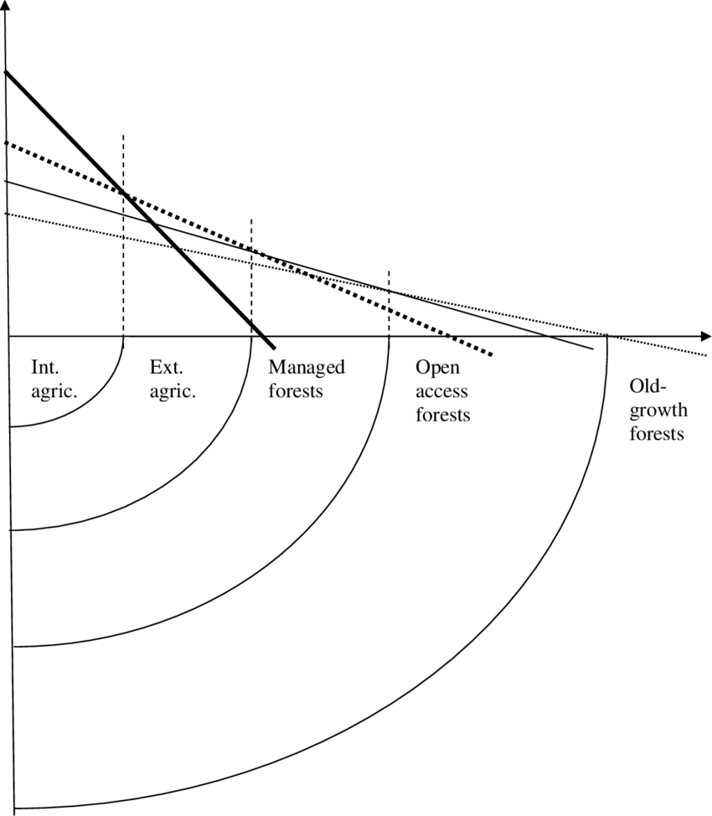
Basic Theme:
Agricultural Intensity of production of a particular crop declines toward off distance from town
Agricultural crop pattern differ in different concentric zone around town. The type of Landuse varies with distance from Market.

Slide 5
Locational Rent
LR = Y (m – c) – Y.td
1 km – Rs. 5000
5 km – 3000
10 km - 500
LR = Locational Rent per Unit Land (?? 500 ; 3000; 5000)
Y = Yield per unit land (100)
m = Market Price (70)
c = Production cost (15)
t = Transport rate per unit distance (Rs. 5 /km)
d = Distance of the Unit of Land from market. (1 km)

Slide 6
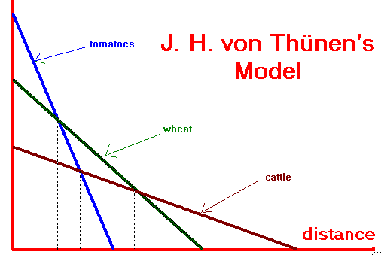
Factors:
Landuse and Cropping Intensity changes in response to
Market Price
Transport Cost
Yield Per Hectare

Slide 7
Land Use Pattern
Zone 1: Horticulture and Milk Production
Zone 2: Firewood and Lumbering Production
Zone 3: Three Zones
Intensive Crop Farming without Fallow
Crop Farming, Fallow and Pasture
Three Field System (Oat – Pasture – Fallow)
Zone 4: Livestock Farming

Slide 8
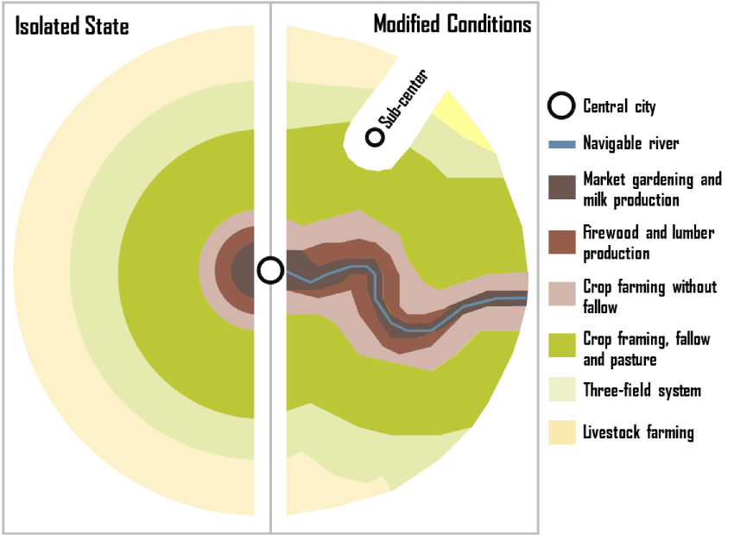

Slide 10
Applicability:
mention where this model can be applied based on the previous discussion.
Criticism:
Criticise the assumptions.

Slide 11
Thank You

