Slide 1
Population Resource Region
Dr. Kaustuv Mukherjee
Assistant Professor
Department of Geography
Chandidas Mahavidyalaya

Slide 2
After W. Zelinsky

Slide 7
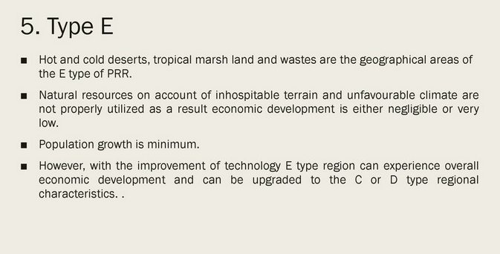

Slide 8
After E.A. Ackerman in 1970
Basis of Classification
Population
Resource
Technology

Slide 9
Classification:
United States Type (Pop – low; resource – high; technology – high; per capita income – high)
Europian Type (Pop – medium; resource – low; technology – very high; per capita income – high)
3.Brazilian type (Pop – low; resource – very high; technology – low; per capita income – medium)
4. China- Egyptian type ((Pop – very high; resource – high; technology – low; per capita income – low)
5. Arctic-Desert type ((Pop – very low; resource – high (undiscovered); technology – low; per capita income – low)

Slide 10
Optimum population
Under-population
Over-population
Population – Resource Relation expressed in this diagram

Slide 11
… further reading continues.
Thank You

