Slide 1
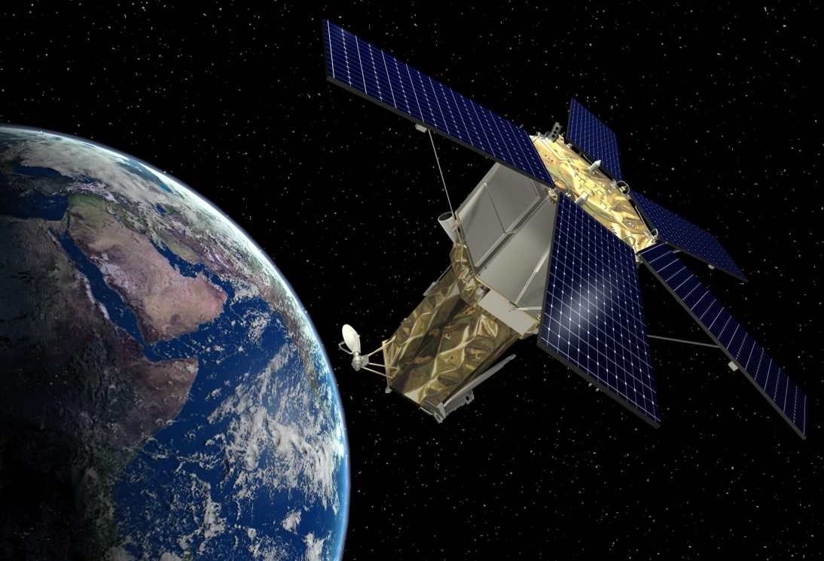
Remote Sensing:
Sensor Resolutions & Colour Composite
Dr. Kaustuv Mukherjee
Assistant Professor
Department of Geography
Chandidas Mahavidyalaya

Slide 2
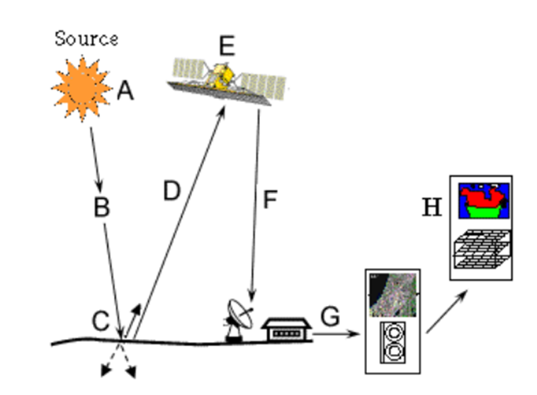
Introduction:
Remote sensing is an art and science of obtaining information about an object or feature without physically coming in contact with that object or feature.
A. Emission of electromagnetic radiation
B. Transmission of energy from the source to the object
C. Interaction of EMR with the object and subsequent reflection and emission
D. Transmission of energy from the object to the sensor
E. Recording of energy by the sensor
F. Transmission of the recorded information to the ground station
G. Processing of the data into digital or hard copy image
H. Analysis of data
Fig. : Important Stages in Remote Sensing (Source: Internet)

Slide 3
Sensor:
There are several types of sensors that are used in remote sensing satellites. These sensors vary according to the purposes for which they are used. Main type of sensors used in remote sensing are -
The Multispectral Scanner
The Thematic Mapper
The Microwave Radiometer
The Synthetic Aperture Radar
The Panchromatic Camera

Slide 4
Resolution:
There are four major types of resolution in remote sensing:
Spatial Resolution
Spectral Resolution
3. Temporal Resolution
4. Radiometric Resolution

Slide 5
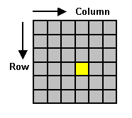
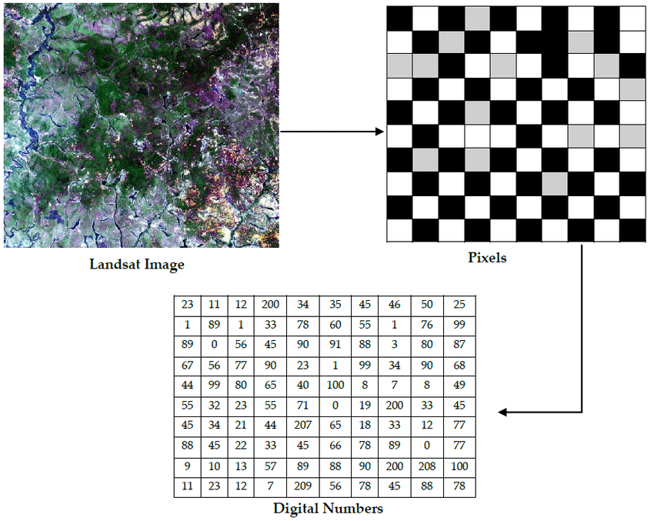
Pixel

Slide 6
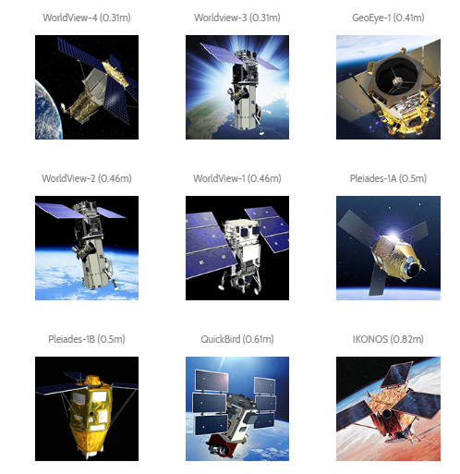
Fig. : Few High Resolution Satellites

Slide 7
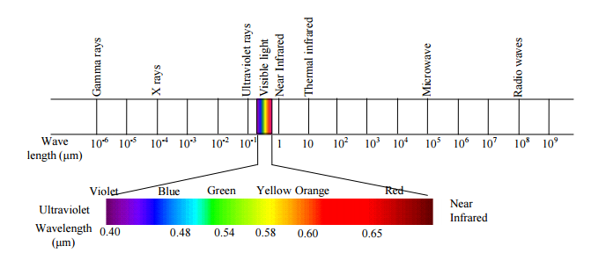
Fig. : Electromagnetic Spectrum

Slide 8
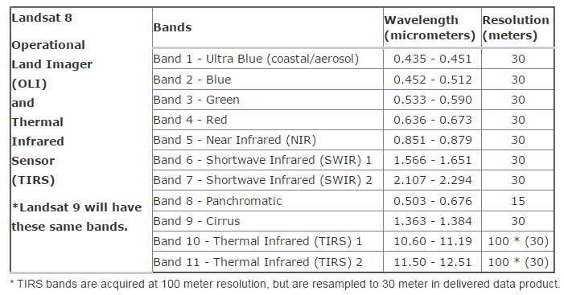
Band Designation
For Landsat 8:
Source: USGS, 2018
For IRS-LISS-III:
Spectral Band | Wavelength | Resolution
Band 1 (Green) | 0.52 - 0.59 µm | 24 m
Band 2 (Red) | 0.62 - 0.68 µm | 24 m
Band 3 (Near Infrared) | 0.77 - 0.86 µm | 24 m
Band 4 (SWIR) | 1.55 - 1.70 µm | 24 m
Source: NRSC-ISRO, 2018

Slide 9
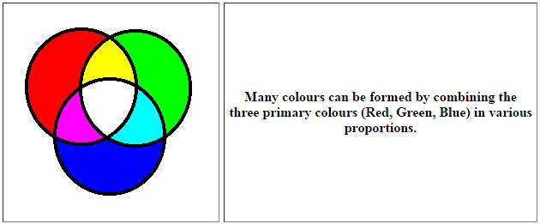
Colour Composite
Fig. : Colour Composition
Visible Range of Colours of Naked Human Eye
Blue | Green | Red

Slide 10
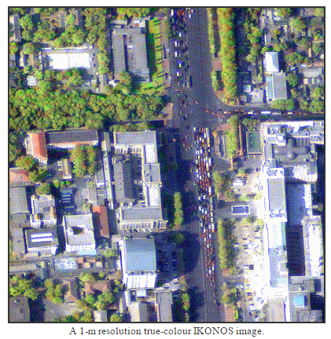
True Colour Composite (TCC):
If a multispectral image consists of the three visual primary colour bands (red, green, blue), the three bands may be combined to produce a "true colour" image. For example, the bands 3 (red band), 2 (green band) and 1 (blue band) of a LANDSAT TM image or an IKONOS multispectral image can be assigned respectively to the R, G, and B colours for display. In this way, the colours of the resulting colour composite image resemble closely what would be observed by the human eyes.
Fig. : TCC from IKONOS Imagery

Slide 11
False Colour Composite (FCC):
The display colour assignment for any band of a multispectral image can be done in an entirely arbitrary manner. In this case, the colour of a target in the displayed image does not have any resemblance to its actual colour. The resulting product is known as a false colour composite image. There are many possible schemes of producing false colour composite images. However, some scheme may be more suitable for detecting certain objects in the image.
Channel | Band | Landsat 8 | IRS LISS-III
Red | NIR band | Band 5 | Band 3
Green | Red band | Band 4 | Band 2
Blue | Green band | Band 3 | Band 1

Slide 12
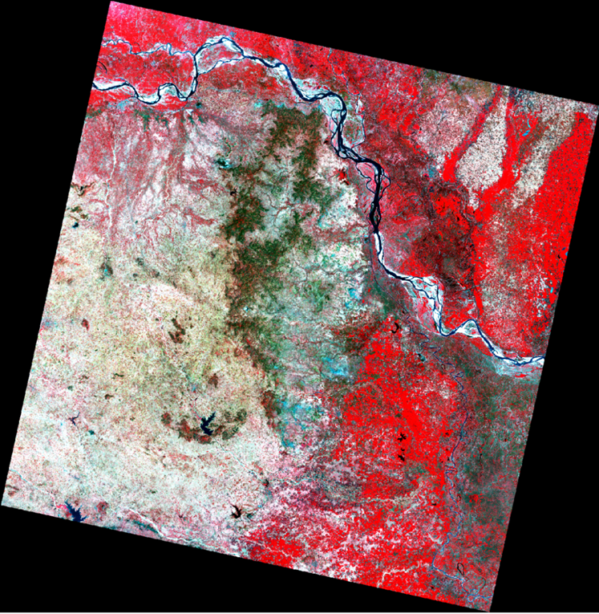
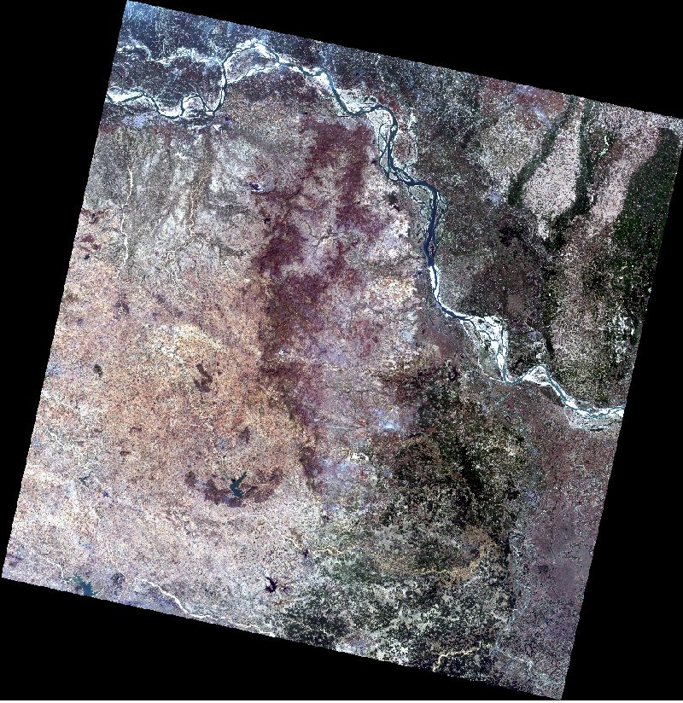
Fig. : FCC prepared from Landsat 8
Fig. : TCC prepared from Landsat 8

Slide 13
Thank You

